Slide 1
University of Basrah Al-zahraa college of medicine
Ministry of higher Education and Scientific Researches
The module: Cardiovascular system
Session: 7
Cellular events in the heart
Group work

Slide 2
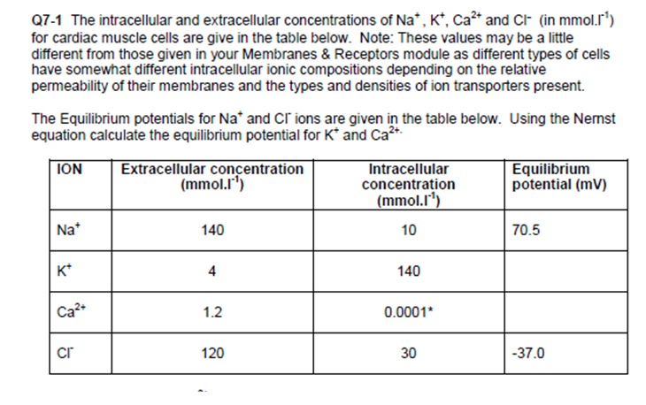
University of Basrah Al-zahraa college of medicine
Ministry of higher Education and Scientific Researches

Slide 3
Resting membrane potential
University of Basrah Al-zahraa college of medicine
Ministry of higher Education and Scientific Researches
Q7-2 What will be the membrane potential of a cell whose membrane was only permeable to K+ ions?
Q7-3 If the cell membrane were only permeable to Na+ ions what would the membrane potential be?
Q7-4 If the cell membrane were permeable only to Cl- what would the membrane potential be?

Slide 4
University of Basrah Al-zahraa college of medicine
Ministry of higher Education and Scientific Researches
Q7-5 If the membrane was permeable only to Ca2+ what would the membrane potential be?
Q7-6 A membrane allowing only K+ to cross will have a potential of - 95mV, one allowing only Na+ to cross a potential of +70 mV. What will the potential be (approx.) if it is 20 times as easy for K+ to cross as Na+ to cross?

Slide 5
The Cardiac Action Potential
University of Basrah Al-zahraa college of medicine
Ministry of higher Education and Scientific Researches
Q7-7 Draw the changes in membrane potential which occur with time during a ventricular action potential and indicate the changes in conductance to Na+, K+ and Ca2+ occurring in the different phases. Remember to label both time and voltage axes clearly.
Q7-8 So long as the Ca2+ channels remain open the membrane will remain depolarised. In the case of ventricular myocardial cells this 'plateau' phase lasts over 200 ms. What will happen to the concentration of Ca2+ in the cell during this time?

Slide 6
The Pacemaker Action Potential
University of Basrah Al-zahraa college of medicine
Ministry of higher Education and Scientific Researches
Q7-9 Draw the changes in membrane potential which occur with time during a pacemaker action potential (include a diastolic period). Label the axes and indicate on your diagram what is happening to the ions channels at different points in the AP.
Q7-10 What ion channels are responsible for the upstroke of the pacemaker action potential?

Slide 7
University of Basrah Al-zahraa college of medicine
Ministry of higher Education and Scientific Researches
Q7-11 What will happen to the interval between action potentials if the membrane depolarises more rapidly during diastole? How will this affect the heart rate?
Q7-12 What will happen to the heart rate if the pacemaker potential depolarises less rapidly?

Slide 8
University of Basrah Al-zahraa college of medicine
Ministry of higher Education and Scientific Researches
Q7-13 You will remember for your lecture on the autonomic nervous system that the slope of the pacemaker potential is affected by the binding of neurotransmitters to receptors on the pacemaker cells. Complete the following:
…….. acts on …….. adrenoreceptors to …….. the slope of the pacemaker potential and so …….. heart rate.
…….. acts on …….. …….. cholinergic receptors to …….. the slope of the pacemaker potential and so …….. heart rate.

Slide 9
Blood Electrolytes and the Heart
University of Basrah Al-zahraa college of medicine
Ministry of higher Education and Scientific Researches
Q7-14 With intracellular [K+] of 140 mmol.l-1 and extracellular [K+] of 4 mmol.l-1 what did you calculate EK to be?
Q7-15 If extracellular [K+] rises to 10mmol.l-1 what will EK now be?
Q7-16 What effect will hyperkalaemia have on the membrane potential of ventricular myocytes in diastole?
Q7-17 What effect might prolonged hyperkalaemia have on the steady state availability of voltage-gated sodium channels?

Slide 10
University of Basrah Al-zahraa college of medicine
Ministry of higher Education and Scientific Researches
Q7-18 What may be the effect of this on the spread of excitation from cell to cell?
Q7-19 What will be the effect of the change of hyperkalaemia on the availability of the ion channels that generate the pacemaker potentials?
Q7-20 What effect will hyperkalaemia have on the pacemaker potential and the heart rate?
Q7-21 What then is the risk to the heart of hyperkalaemia?

Slide 11
University of Basrah Al-zahraa college of medicine
Ministry of higher Education and Scientific Researches
Q7-22 What effect will hypokalaemia have upon the membrane potential of ventricular myocytes in diastole?
Q7-23 What effect will hypokalaemia have on the spread of excitation from cell to cell?
Q7-24 What will the effect of hypokalaemia be on the pacemaker potential?
Q7-25 What then is the risk of hypokalaemia?

